Slide 1
Unit 3
Introduction to JQuery & Ajax
43237 43239 43244 Neelanjney Pilarisetty Pallavi Dadape Hrishikesh Pawar

Slide 2
INTRODUCTION TO JQUERY

Slide 4
INTRODUCTION TO AJAX
Asynchronous JavaScript And XML
Used to communicate with the server without refreshing the web page and thus increasing the user experience and better performance.
NOT a programming language.
Combination of -
browser built-in XMLHttpRequest object (to request data from a web server)
JavaScript and HTML DOM (to display or use the data)
AJAX is based on the following open standards −
Browser-based presentation using HTML and Cascading Style Sheets (CSS).
Data is stored in XML format and fetched from the server.
Behind-the-scenes data fetches using XMLHttpRequest objects in the browser.
JavaScript to make everything happen.

Slide 5
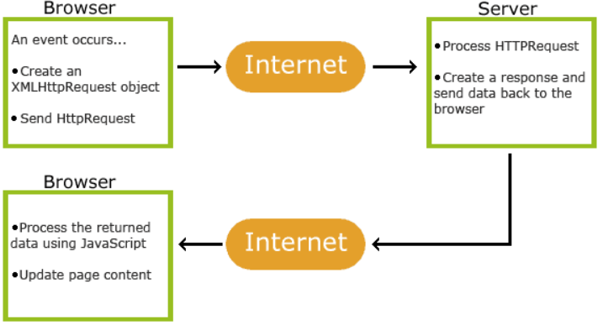
How AJAX works

Slide 6
Advantages
Disadvantages
Speed is enhanced as there is no need to reload the page again.
AJAX make asynchronous calls to a web server, this means client browsers avoid waiting for all the data to arrive before starting of rendering.
Form validation can be done successfully through it.
Bandwidth utilization – It saves memory when the data is fetched from the same page.
More interactive.
Ajax is dependent on Javascript. If there is some Javascript problem with the browser or in the OS, Ajax will not support.
Ajax can be problematic in search engines as it uses Javascript for most of its parts.
Source code written in AJAX is easily human readable. There will be some security issues in Ajax.
Difficult debugging.
Problem with browser back button when using AJAX enabled pages.

Slide 7
AJAX - Send a request to a server
XMLHttpRequest object can be used to exchange data with a server behind the scenes.
var xhttp = new XMLHttpRequest();
It supports GET and POST http requests.
open(method, url, async) | Specifies the type of request method: the type of request: GET or POST url: the server (file) location async: true (asynchronous) or false (synchronous)
send() | Sends the request to the server (used for GET)
send(string) | Sends the request to the server (used for POST)

Slide 8
GET Request
GET is used to request data from a specified resource
The query string (name/value pairs) is sent in the URL of a GET request
GET requests can be cached
GET requests remain in the browser history
GET requests can be bookmarked
GET requests should never be used when dealing with sensitive data
GET requests have length restrictions
GET requests are only used to request data (not modify)

Slide 9
POST Request
POST is used to send data to a server to create/update a resource
The data sent to the server with POST is stored in the request body of the HTTP request
POST requests are never cached
POST requests do not remain in the browser history
POST requests cannot be bookmarked
POST requests have no restrictions on data length

Slide 10
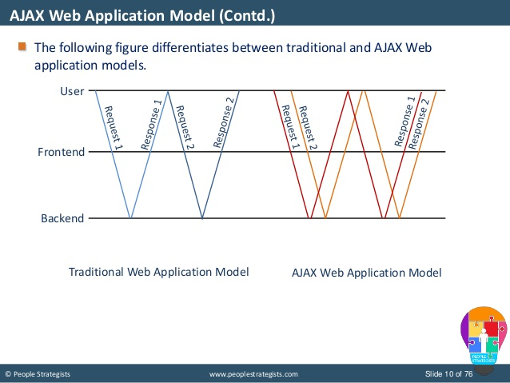
COMPARISON

Slide 11
COMPARISON: AJAX
AJAX stands for Asynchronous JavaScript and XML.
It is a group of web development programs used to design websites. The programs create interactive web applications using a combination of XHTML for basic programming, CSS for styling.
AJAX enables web pages to send data to and receive data from a server without changing or hindering the web page itself. AJAX eliminates the need for the customers to wait, making interaction between the customer and the server asynchronous.
Google is the biggest known supporter of AJAX and has invested millions of dollars to advance it. Major Google products, such as Orkut, Gmail, Google Suggest, and Google Maps are AJAX applications. Amazon has also launched it’s own search engine, A9, on AJAX.
Ajax is not a single technology. It is a group of technologies. Jesse James Garrett, the one who coined the term, AJAX, lists the various technologies incorporated in AJAX:

Slide 12
COMPARISON: JQUERY
jQuery, on the other hand, is a multi-browser JavaScript library. jQuery is a free, open source software. It is licensed under the MIT License. It was designed to simplify the client-side scripting of HTML and is currently used by numerous websites.
jQuery's syntax is designed to make it easier to navigate a document, select DOM elements, create animations, handle events, and develop Ajax applications. In addition to the JavaScript library, jQuery also provides capabilities for developers to create plug-ins.
The advantage of this is that it enables developers to create abstractions for low-level interaction and animation, advanced effects and high-level, theme-able widgets. Furthermore, the approach to the jQuery library allows the creation of powerful dynamic web pages and web applications.

Slide 13
SUMMARY
AJAX is a combination of several technologies, such as CSS, HTML, DOM, etc. Whereas, jQuery is a straightforward JavaScript library.
In addition to being a combination of technologies, Ajax provides new functionalities by combining the said technologies. jQuery cannot provide a new functionality by combining with other technologies.
Ajax should be accessed in a proper procedure to retrieve data from the server. jQuery can be accessed through front-end.
jQuery handles front end tasks while AJAX handles backend (server calls).
jQuery does not require understanding of the complete procedure to setup a page.
Heavy usage of Ajax may lead to overloading of the server due to the number of connections created. jQuery does not face such a problem.
AJAX and jQuery are often used together.
In order to use AJAX, one would need a client side scripting language that allows one to detect the actions of the user and modify elements on the page accordingly. jQuery does that.

Slide 14
EXERCISE
Quiz Link -

